Slide 1
DOMODEDOVO
INVESTMENT PASSPORT

Slide 2
“Investment is a key driver for economy development today. The Domodedovo Urban District is one of the leaders in terms of the amount of the raised investment among the municipalities of the Moscow Region.
A developed transport infrastructure, efficient approaches to investor relations and existence of respective competencies allow our District to be investment-attractive and implement the most ambitious investment projects.”
A.V. Dvoinykh
Head of the Domodedovo Urban District
of the Moscow Region

Slide 3
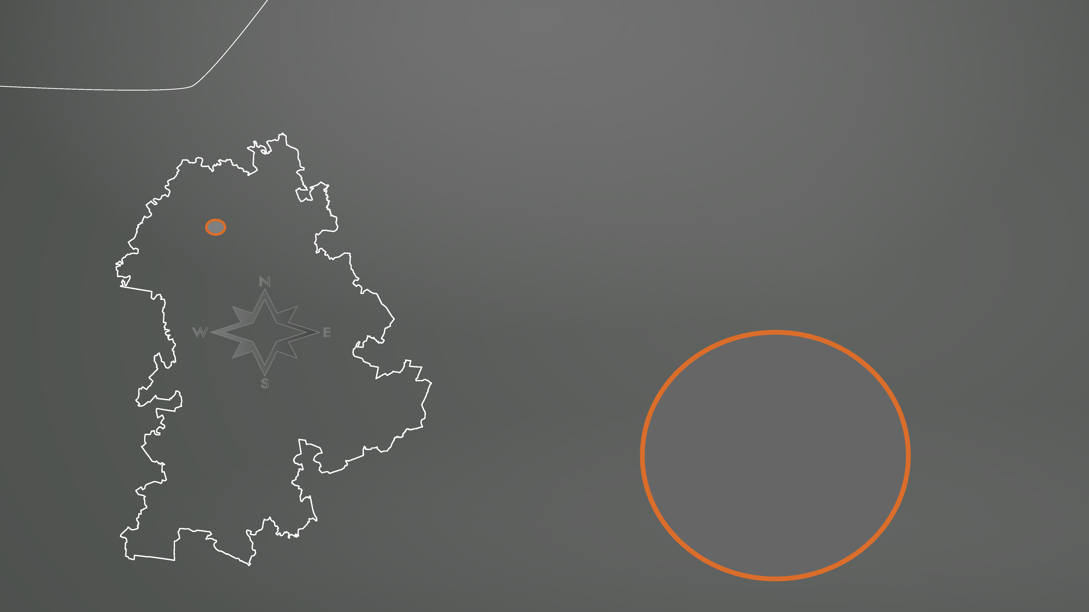
GEOGRAPHY
Leninsky District
The Domodedovo Urban District is a well-established alternative center of the Moscow agglomeration in the southern part of the central area of the Moscow Region.
Domodedovo
Podolsk
Urban District
Ramenskoye District
81.8
thousand hectares
Chekhov Urban District

Slide 4
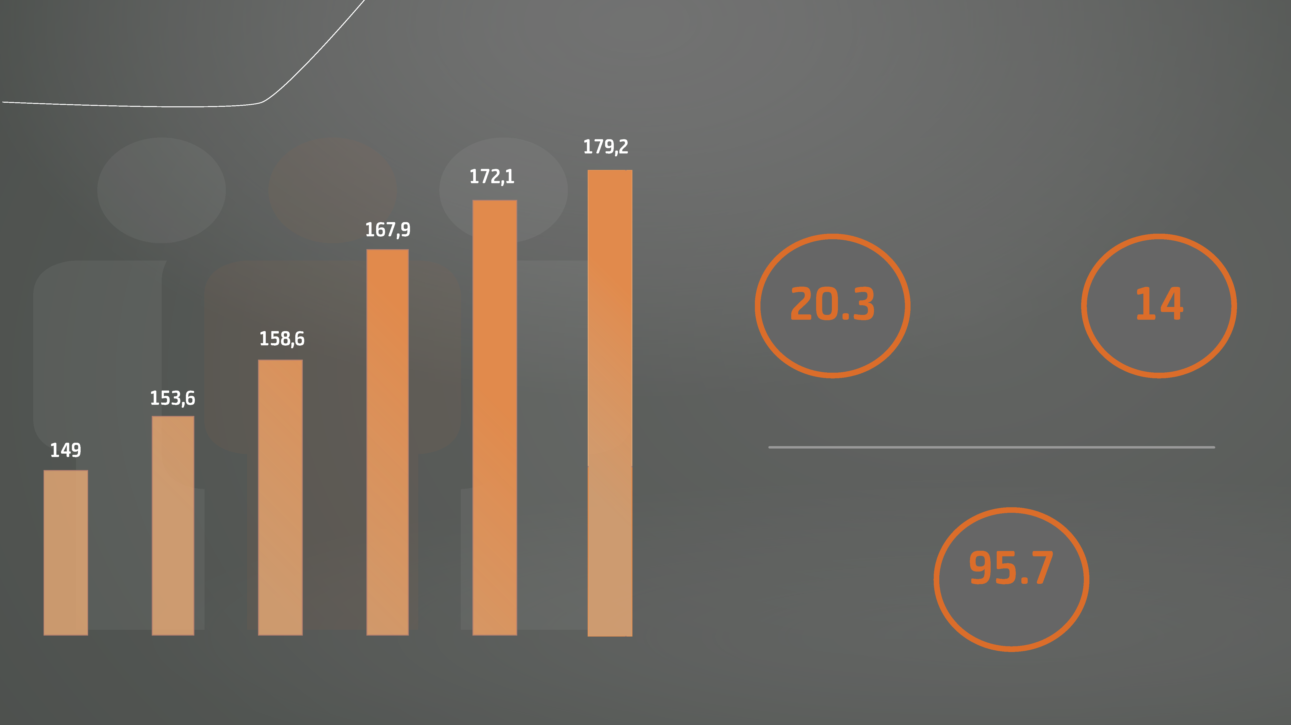
DEMOGRAPHY
High Population Growth Rates (2013-2018)
th
population
growth
place
in the Moscow Region
Employable Population
thousand people
Population, ‘000 people

Slide 5
ECONOMY STRUCTURE
Own-produced Goods Shipped, by Industry Sector
Other Services 4%
Social Sphere Services 4%
Real Property Transactions 4%
Hotels and Restaurants 1%
Agriculture 1%
Trading 2%
Construction 4%
Transportation and Storage 6% Industrial Production 10%
Airport Complex 64%
Top 5 in the Moscow Region in terms of investment raising
Annual economic development growth rate of no less than 5%
Annual growth of incomes to the consolidated budget of no less than 8%
+ 2000 jobs annually

Slide 6
FOR REFERENCE
RUR
64,156
Average Monthly Wage
(at medium and big companies)
Key Labor Market Indicator
(unemployment level)
0.38
%
air transport
RUR 165,000
industry
RUR 64,000
construction
RUR 62,000
education
RUR 50,000
health care
RUR 58,000
trading
RUR 56,000

Slide 7
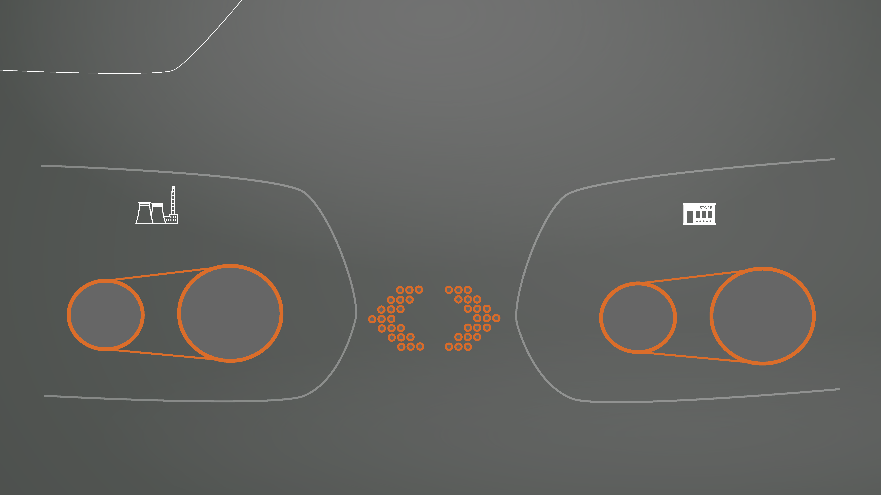
FOR REFERENCE
Cadastre Value of Land Plots (per sq m)
industry
trading
RUR 661
RUR 12,530
RUR
4,254
RUR 182
to
to

Slide 8
FOR REFERENCE
Tariffs for Services of Resource Suppliers
electricity
5.38 RUR/KW*h
gas supply
6.46 RUR/cu m
water supply
25.80 RUR/cu m
water disposal
27.58 RUR/cu m
heat supply
2,535.46 RUR/GCal

Slide 9
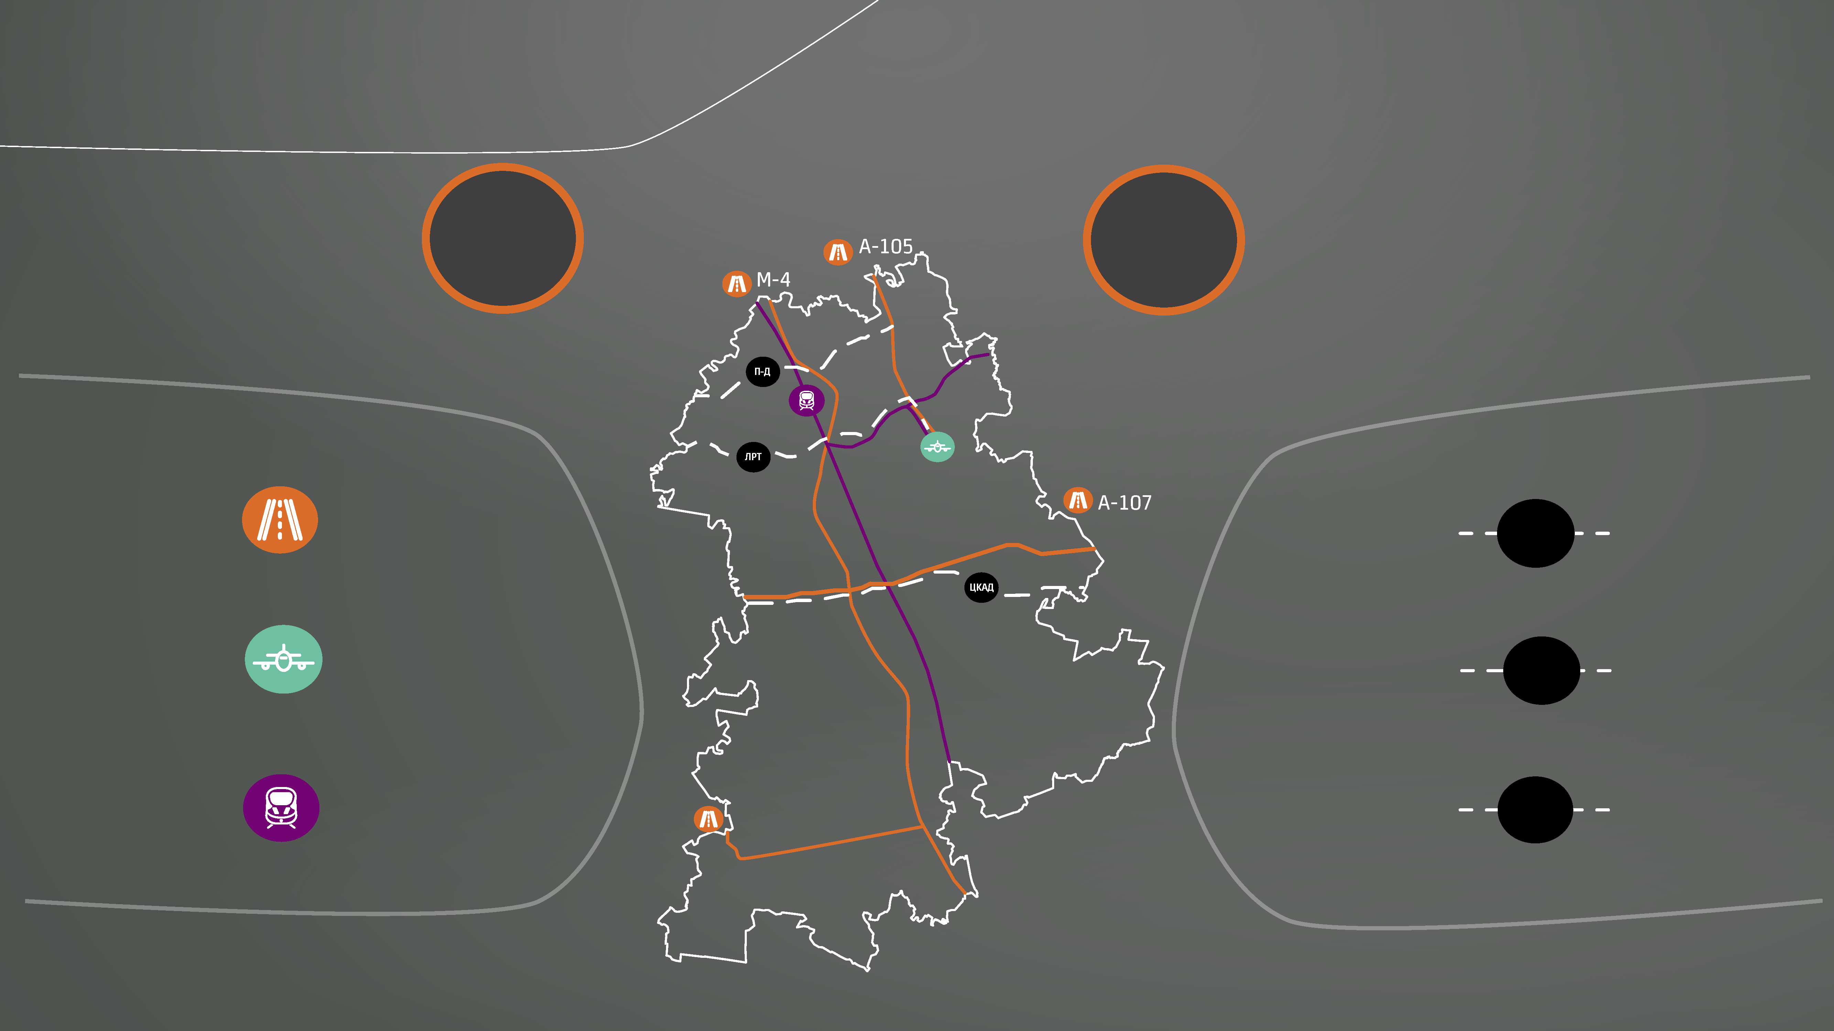
TRANSPORT BACKBONE
13
km
to the Moscow Ring Road
15
min
to the Moscow Ring Road
Existing
Prospective
P-D
federal automobile roads
Podolsk – Domodedovo Automobile Road
CARR
Domodedovo International Airport
Central Automobile Ring Road
LRT
Paveletskaya Railroad
Light Rail Tram

Slide 10
EDUCATION AND HUMAN RESOURCES
Educational System
Main Training Areas
Main Labor Area of Expertise
80
educational establishments
41.5
thousand
students
ground transport specialists
transport companies
economic education
industrial companies
municipal educational establishments 29
pre-school educational establishments
further education establishments
colleagues
higher educational establishments
legal education
trading companies
44
construction
service providers
6
1
3

Slide 11
BIG COMPANIES
amount of investment business area
RUR 81.5 billion
transportation business
amount of investment
business area
RUR 6.7 billion
production of beverages
amount of investment business area
RUR 5.9 billion
food industry
amount of investment business area
RUR 3.5 billion
food industry

Slide 12
INVESTMENT PROJECTS
Agricultural Product Processing Center
RUR 18.8
billion
investment
1000
people
jobs
92,000
sq m
area

Slide 13
INVESTMENT PROJECTS
National Distribution Center
RUR 6.8
billion
investment
1000
people
jobs
138,000
sq m
area

Slide 14
INVESTMENT PROJECTS
Business Tourism Center
RUR 137
billion
investment
24 000
people
jobs
1.4
million sq m
area

Slide 15
INVESTMENT PROJECTS
Special Economic Zone
RUR
14
billion
investment
2200
persons
jobs
2500
hectares
area

Slide 16
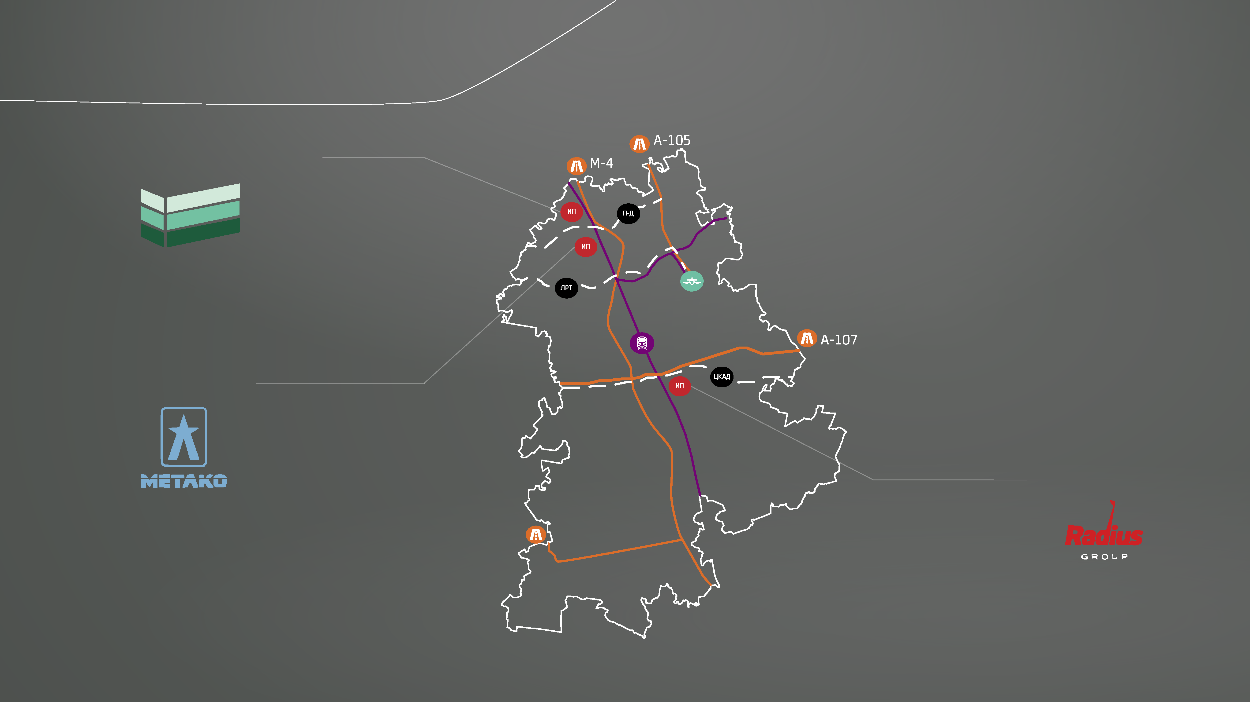
INDUSTRIAL PARKS
Northern Domodedovo
Metako
Southern Gate

Slide 17
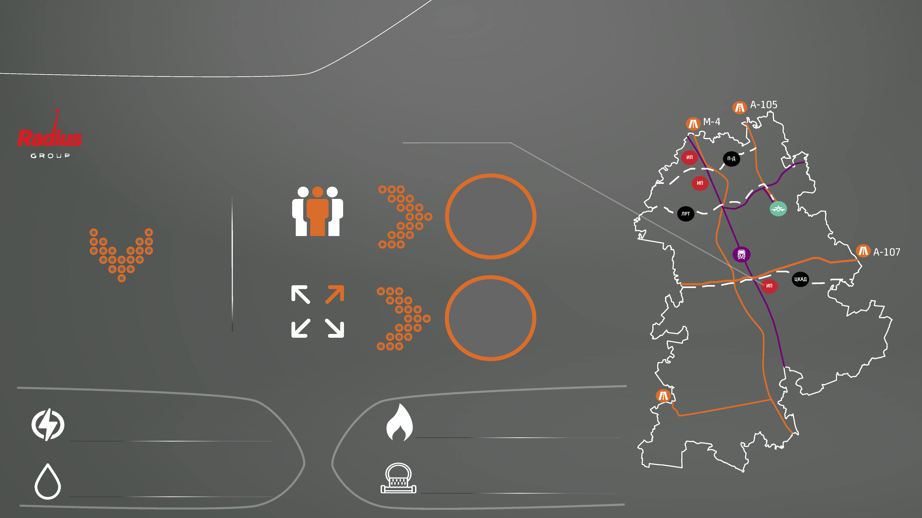
INDUSTRIAL PARKS
Southern Gate Industrial Park
specializes in
20
residents
residents
warehousing and storage
138
hectares
area
32 MW
gas supply
19.2 cu m/year
electricity
450 cu m/day
water disposal
450 cu m/day
water supply

Slide 18
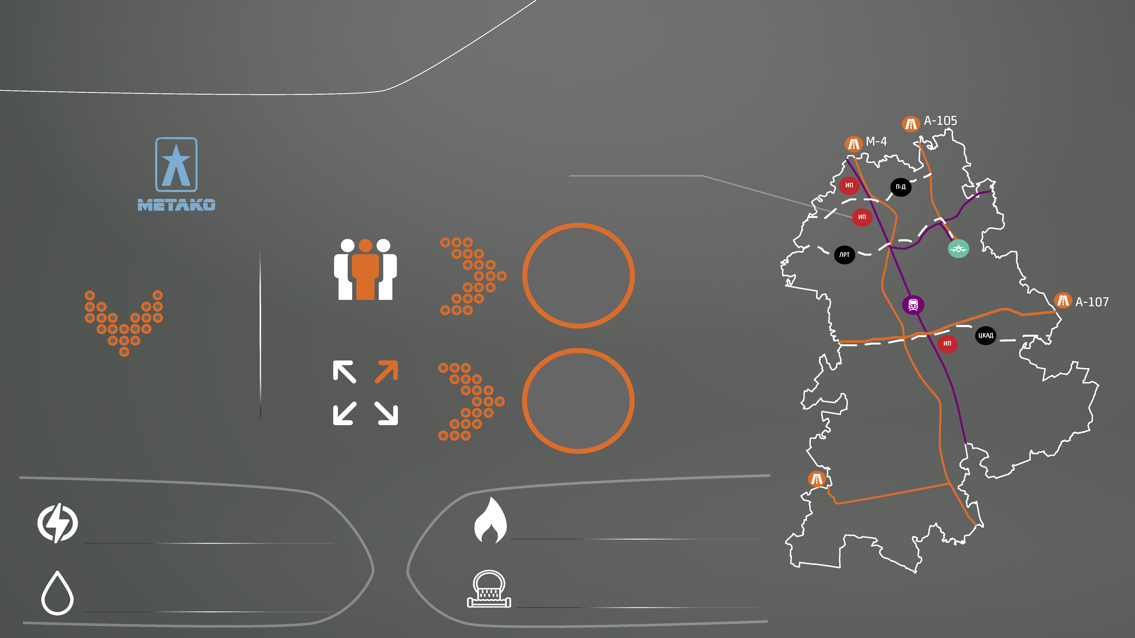
INDUSTRIAL PARKS
Metako Industrial Park
specializes in
28
residents
residents
production of metallic structures
11.6
hectares
area
3061 MW
gas supply
115.7 cu m/year
electricity
554 cu m/day
water disposal
554 cu m/day
water supply

Slide 19
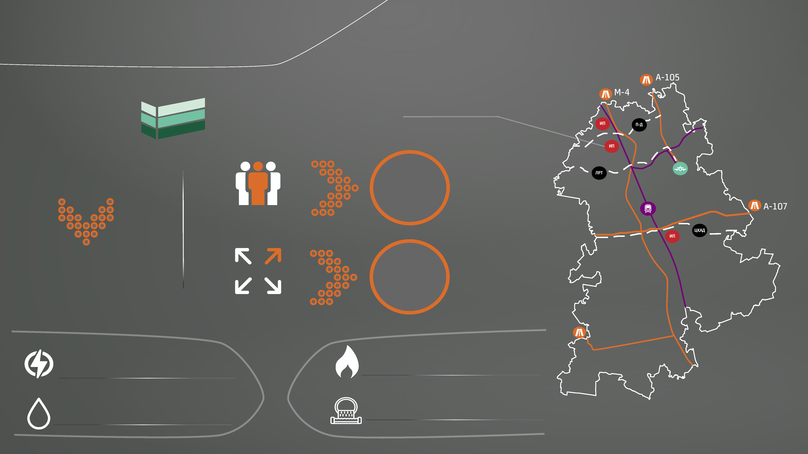
INDUSTRIAL PARKS
Northern Domodedovo Industrial Park
specializes in
72
residents
residents
warehousing and storage
175.3
hectares
area
29 MW
gas supply
895 cu m/year
electricity
71 cu m/day
water disposal
71 cu m/day
water supply

Slide 20
LAND PLOTS
cadastre number
area
sq m
type of permitted use
address
50:28:0010701:16
3,000
Motorway services facilities
Tsentralny Micro District
50:28:0010701:17
3,000
Motorway services facilities
Tsentralny Micro District
50:28:0010701:18
3,000
Motorway services facilities
Tsentralny Micro District
50:28:0100103:2071
6,377
Markets; shops; public catering; motorway services facilities
Belye Stolby Micro District

Slide 21
LAND PLOTS
cadastre number
area sq m
type of permitted use
address
50:28:0030236:706
38,025
Light industry, construction industry, warehouses
Belye Stolby Micro District
50:28:0010620:7
11,700
Zapadny Micro District
Sport
50:28:0000000:54755
21,542
Construction industry
Rastunovo Village
50:28:0060115:1390
19,481
Dolmatovo Village
Warehouses

Slide 22
LAND PLOTS
cadastre number
area sq m
type of permitted use
адрес
50:28:0100103:2068
6,000
Markets; shops; public catering; motorway service facilities
Belye Stolby Micro District
50:28:0100103:2072
7,000
Markets; shops; public catering; motorway service facilities
Belye Stolby Micro District
50:28:0100103:2073
8,000
Markets; shops; public catering; motorway service facilities
Belye Stolby Micro District

Slide 23
LAND PLOTS
cadastre number
area sq m
type of permitted use
address
50:28:0100103:2074
9,000
Markets; shops; public catering; motorway service facilities
Belye Stolby Micro District
50:28:0100103:2070
10,000
Markets; shops; public catering; motorway service facilities
Belye Stolby Micro District
50:28:0100103:2069
11,000
Retailing facilities (shopping centers, shopping malls)
Belye Stolby Micro District
50:28:0000000:55224
108,895
Warehouses
Belye Stolby Micro District

Slide 24
SUPPORT INFRASTRUCTURE ORGANIZATIONS
Chamber of Commerce and Industry of the Domodedovo Urban District Union
Alliance of Business Cooperation Non-commercial Partnership
Domodedovo Union of Industrialists and Entrepreneurs
Head:
Alexander Sergeevich Pashkov
Contact telephone number:
8 (916) 950-02-88
E-mail:
mail@tppdmd.ru
Head: Vyacheslav Anatolievch Starikov
Contact telephone number:
8 (496) 79-3-03-59, ф. 8(496) 79-3-35-43
E-mail: zaoorel@mail.ru
Head:
Mikhail Alexandrovich Kokorin Contact telephone number:
8(496)793-53-72, 8(495)780-08-47
E-mail: kokorin@buscons.ru

Slide 25
SUPPORT MEASURES
Tax benefits during implementation of investment projects
Renting out land plots
without tenders
Preferential loans
Support of foreign economic activities (export)
Subsidy for creation of utility infrastructure facilities

Slide 26
HELPFUL INFORMATION
GENERAL MATTERS OF IMPLEMENTATION OF INVESTMENT PROJECTS
Pavel Andreevich GOROKHOV
Deputy Chairman of the Committee for Economy – Head of the Investment and Entrepreneurship Section
Contacts:
Telephone: +7(496) 792-41-27
E-mail: gorohov@domod.ru
ДОМОДЕДОВО

Slide 27
HELPFUL INFORMATION
MATTES OF ARCHITECTURE AND TOWN-PLANNING
Georgy Alexeevich BELUKHIN
Chief Architect
Contacts:
Telephone: +7(496) 792-41-51
E-mail: belukhin@domod.ru
ДОМОДЕДОВО

Slide 28
HELPFUL INFORMATION
MATTERS OF LAND AND PROPERTY RELATIONS
Yevgenia Mikhailovna KHRUSTALEVA
Deputy Head of the Administration – Chairman of the Property Management Committee
Contacts:
Telephone: +7(496) 792-41-39
E-mail: khrustaleva@domod.ru
ДОМОДЕДОВО

Slide 29
HELPFUL INFORMATION
MATTERS OF CONSTRUCTION AND UTILITY INFRASTRUCTURE
Alexander Alexandrovich GORBUNOV
Deputy Head of the Administration
Contacts:
Telephone: +7(496) 792-41-07
E-mail: gorbunov@domod.ru
ДОМОДЕДОВО

Slide 30
DOMODEDOVO
WELCOME ABOARD

